Slide 1
AI

Slide 2
Artificial Intelligence
8.3.5 Knowledge Representation (Ch. 12)

Slide 3
Semantics of FOL
FOL sentences can be assigned a value of true or false.
ISA(Milo,Cat) = true
Milo is younger than Martin
<(AgeOf(Milo),AgeOf(Martin)) = true
=(AgeOf(Milo),AgeOf(Martin)) = false

Slide 4
Examples with Quantifiers
All cats eat fish
∀x:ISA(x,Cat)⇒EatFish(x)

Slide 5
Representing Events
Martin ate
Martin ate in the morning
Martin ate fish
Martin ate fish in the morning

Slide 6
One Possible Representation
FOL representations
Eating1(Martin)
Eating2(Martin,Morning)
Eating3(Martin,Fish)
Eating4(Martin,Fish,Morning)
Meaning postulates
Eating4(x,y,z) -> Eating3(x,y)
Eating4(x,y,z) -> Eating2(x,z)
Eating4(x,y,z) -> Eating1(x)
Example from Jurafsky and Martin

Slide 7
Second Possible Representation
Eating4(x,y,z)
With some arguments unspecified
Problems
Too many commitments
Hard to combine Eating4(Martin,Fish,z) with Eating4(Martin,y,Morning)
Example from Jurafsky and Martin

Slide 8
Third Possible Representation
Reification
∃ e: ISA(e,Eating) ∧ Eater(e,Martin) ∧ Eaten(e,Fish)
Example from Jurafsky and Martin

Slide 9
Outline
Ontologies
Categories and objects
Events
Times
Beliefs

Slide 10
Knowledge Representation
Representing events, time, physical objects, and beliefs
Upper ontology

Slide 11
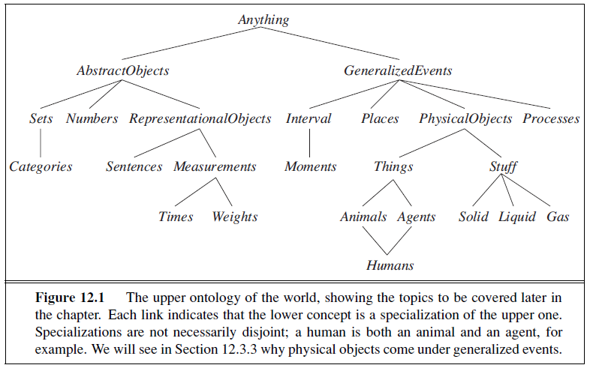
Upper Ontology

Slide 12
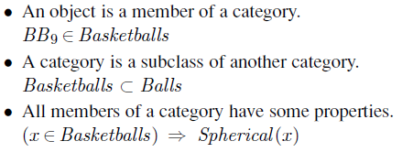
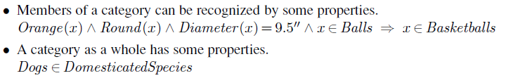
Representing categories

Slide 13
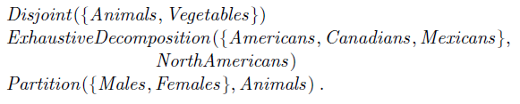

Partitions

Slide 14
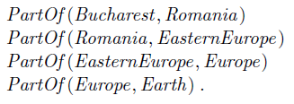

PartOf relations

Slide 15
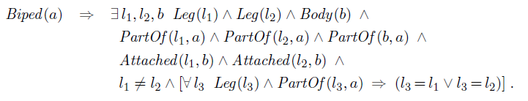
Composite Objects

Slide 16

Measurements

Slide 17
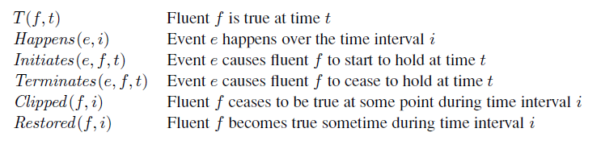
Events

Slide 18

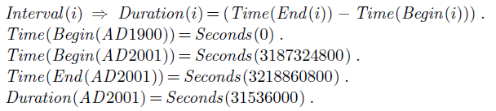

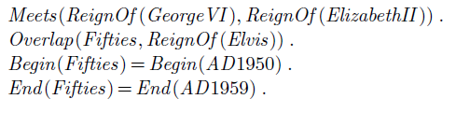
Time Intervals

Slide 19
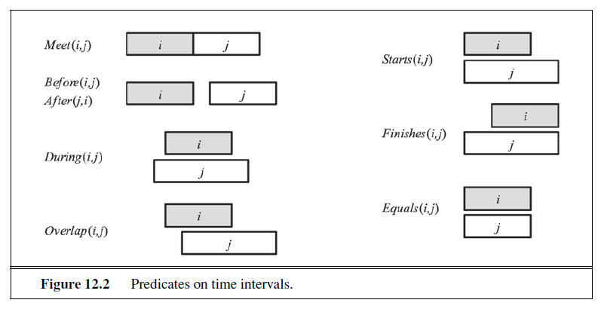

Slide 20
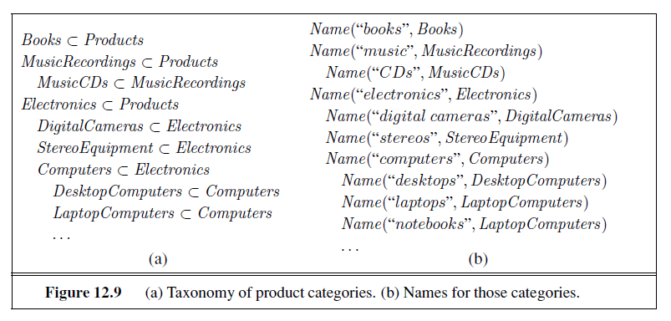
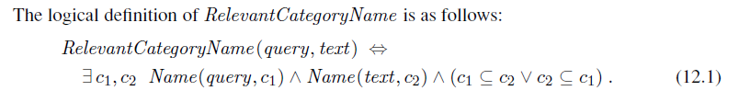

Slide 21
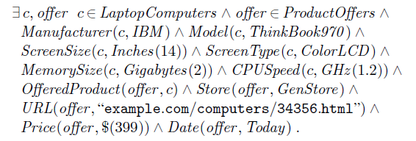
Description Logic

Slide 22
Artificial Intelligence
Semantic Parsing (from 3.6.5)

Slide 23
Semantic Parsing
Converting natural language to a logical form
e.g., executable code for a specific application
Example:
Airline reservations
Geographical query systems

Slide 24
Stages of Semantic Parsing
Input
Sentence
Syntactic Analysis
Syntactic structure
Semantic Analysis
Semantic representation

Slide 25
Compositional Semantics
Add semantic attachments to CFG rules
Compositional semantics
Parse the sentence syntactically
Associate some semantics to each word
Combine the semantics of words and non-terminals recursively
Until the root of the sentence

Slide 26
Example
Input
Javier likes pizza
Output
like(Javier, pizza)

Slide 27
Example
S -> NP VP {VP.Sem(NP.Sem)} t
VP -> V NP {V.Sem(NP.Sem)} <e,t>
NP -> N {N.Sem} e
V -> likes {λ x,y likes(x,y) <e,<e,t>>
N -> Javier {Javier} e
N -> pizza {pizza} e

Slide 28
Semantic Parsing
Associate a semantic expression with each node
S: likes(Javier, pizza)
N: Javier
VP: λx likes(x,pizza)
Javier
V: λ x,y likes(x,y)
N: pizza
likes
pizza

Slide 29
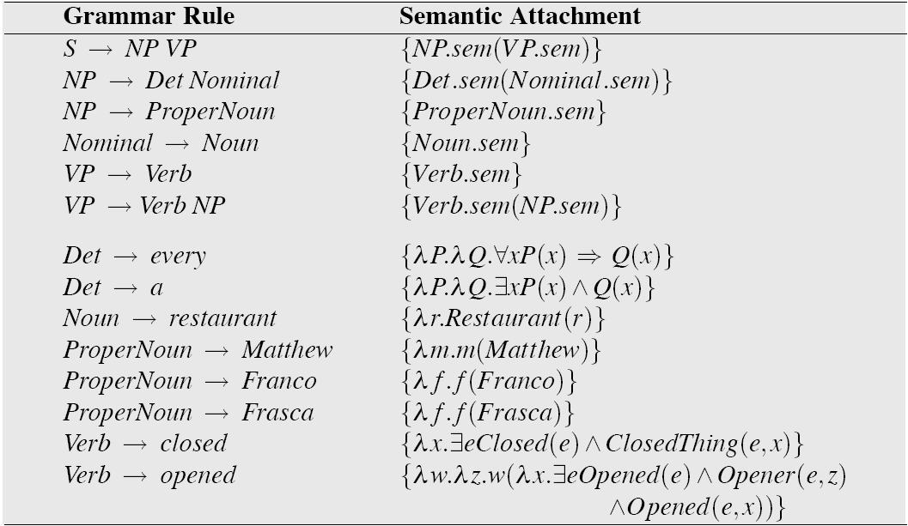
Grammar with Semantic Attachments
Example from Jurafsky and Martin

Slide 30
Using CCG (Steedman 1996)
CCG representations for semantics
ADJ: λx.tall(x)
(S\NP)/ADJ : λf.λx.f(x)
NP: YaoMing
YaoMing is tall
NP (S\NP)/ADJ ADJ
YaoMing λf.λx.f(x) λx.tall(x)
>
S\NP
λx.tall(x)
<
S
Tall (YaoMing)

Slide 31
CCG Parsing
Example:
https://bitbucket.org/yoavartzi/spf
Tutorial by Artzi, FitzGerald, Zettlemoyer
http://yoavartzi.com/pub/afz-tutorial.acl.2013.pdf

Slide 32
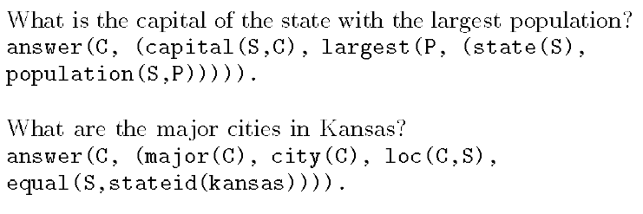
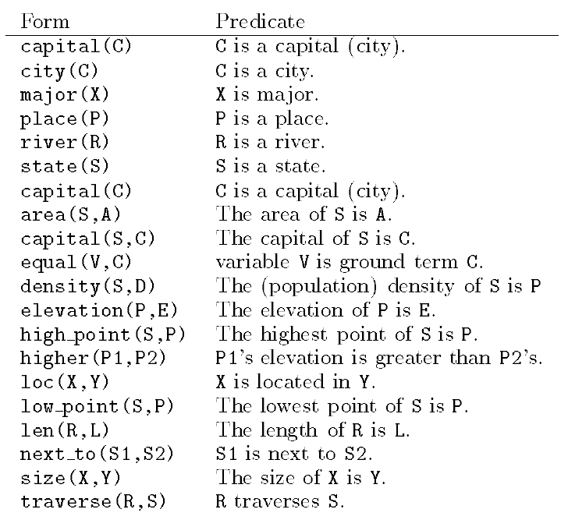
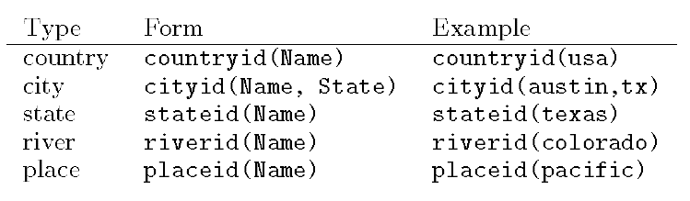
GeoQuery (Zelle and Mooney 1996)

Slide 33
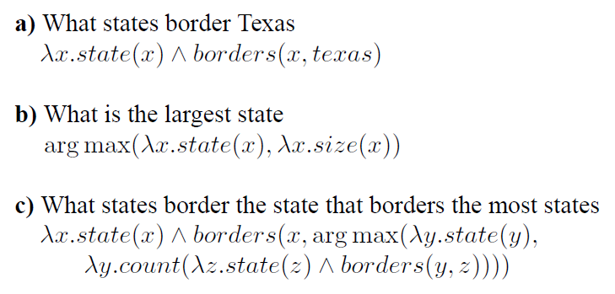
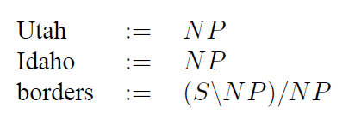
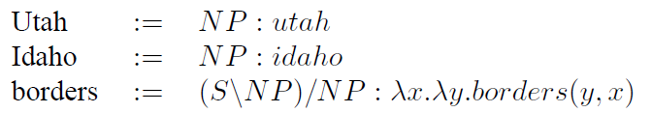
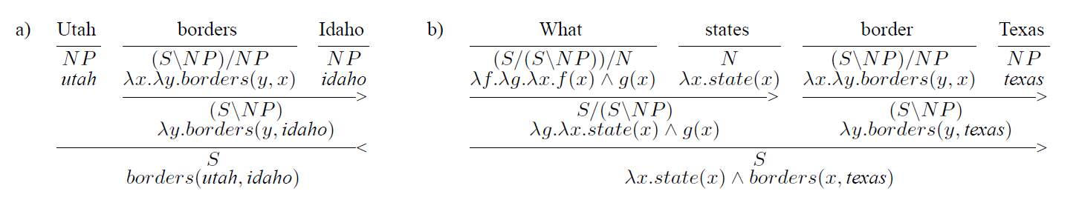
Zettlemoyer and Collins (2005)

Slide 34
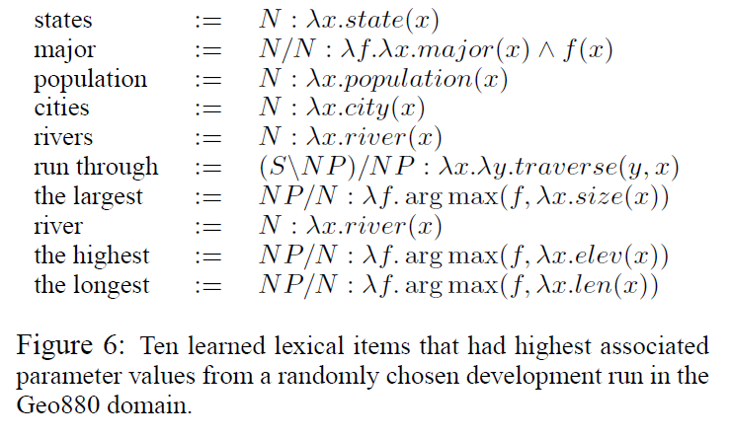
Zettlemoyer and Collins (2005)

Slide 35
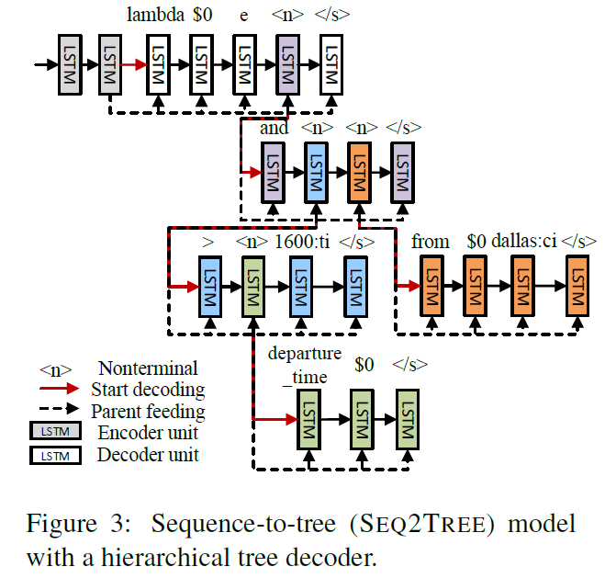
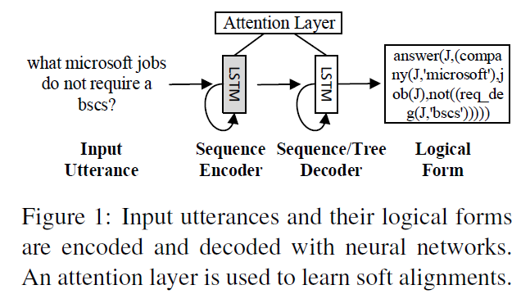
Dong and Lapata (2016)

Slide 36
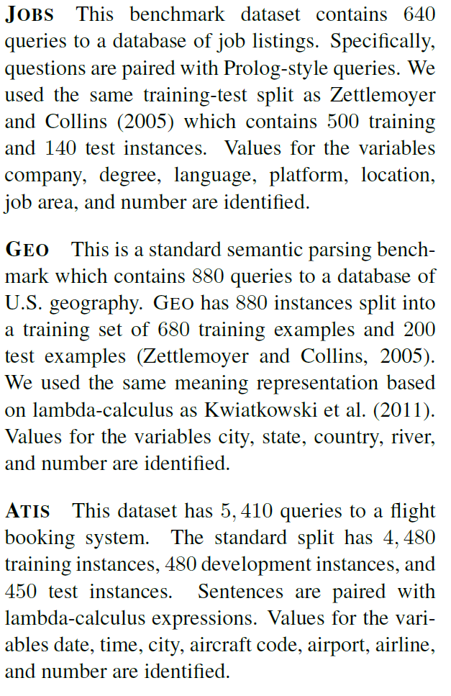
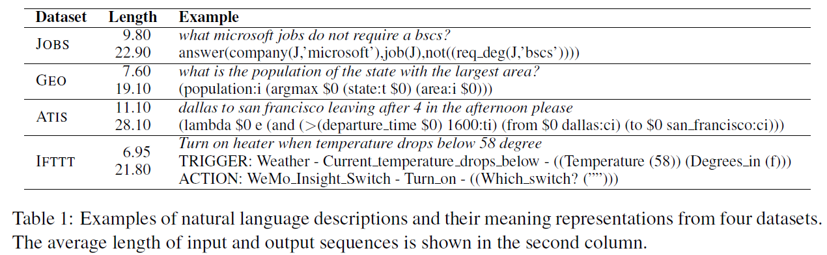
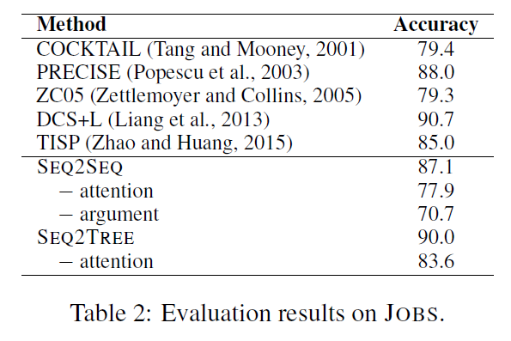
Dong and Lapata (2016)

Slide 37
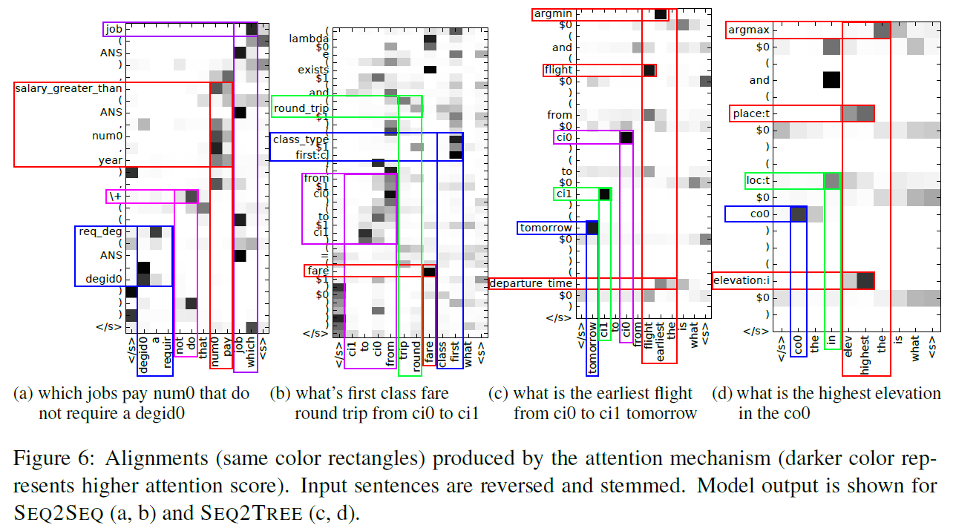
Dong and Lapata (2016)

Slide 38
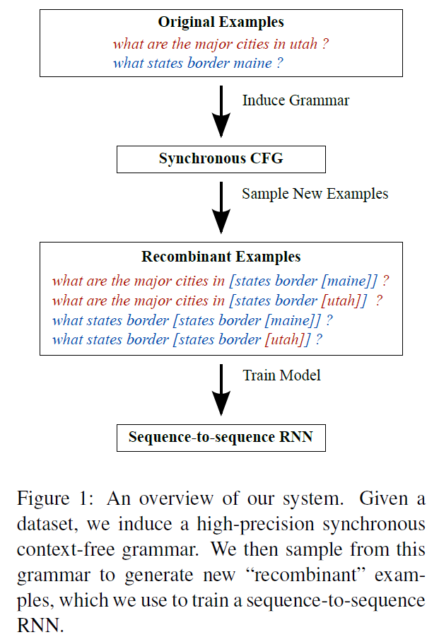
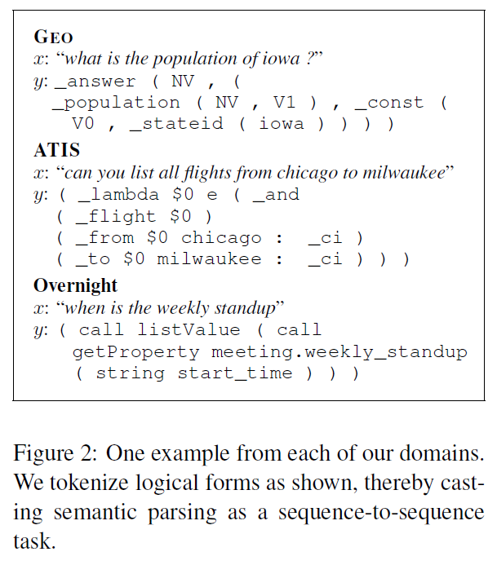
Jia and Liang 2016

Slide 39
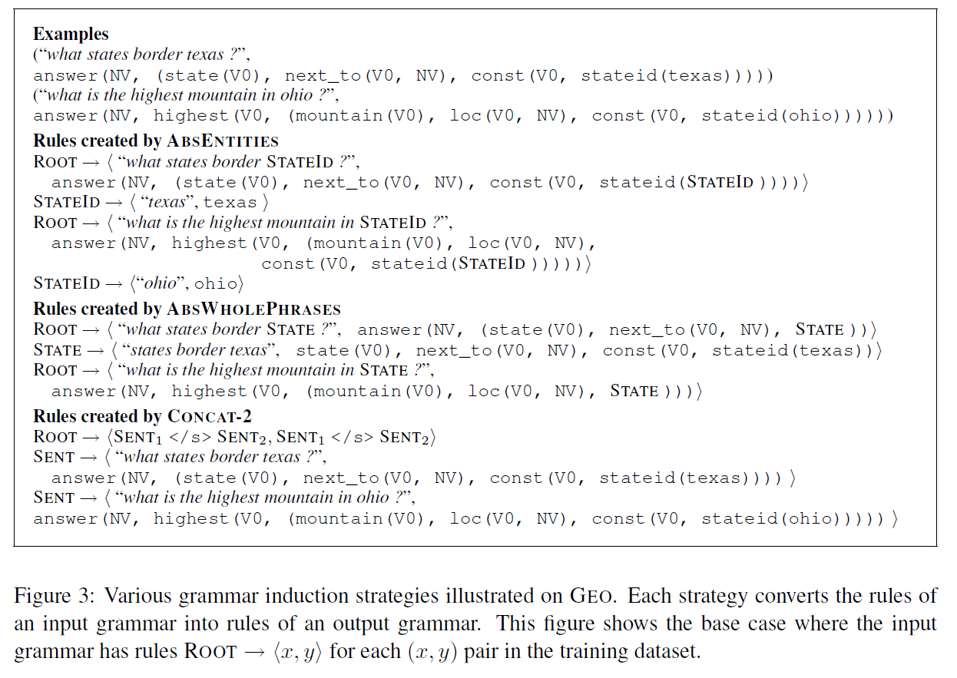

Slide 40
AI

